Slide 1
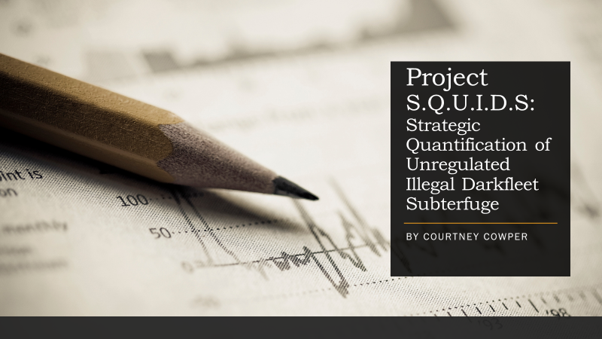

Slide 2
How Do You Catch A Fleet That is Practically Invisible?
The challenge of chasing an untraceable enemy dedicated to mass consumption and the denial of these actions

Slide 3
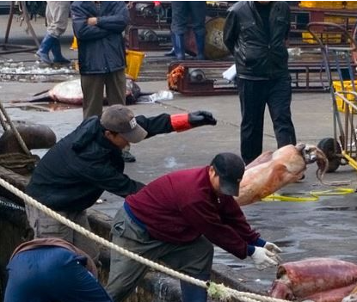
THE PRICE OF PROGRESS
Fishing has been a vital part of human existence for over a thousand years in terms of culture and survival. For centuries, the ocean was this monstrous entity, so vast and so seemingly infinite that there surely was no way humans could ever harm it.

Slide 4
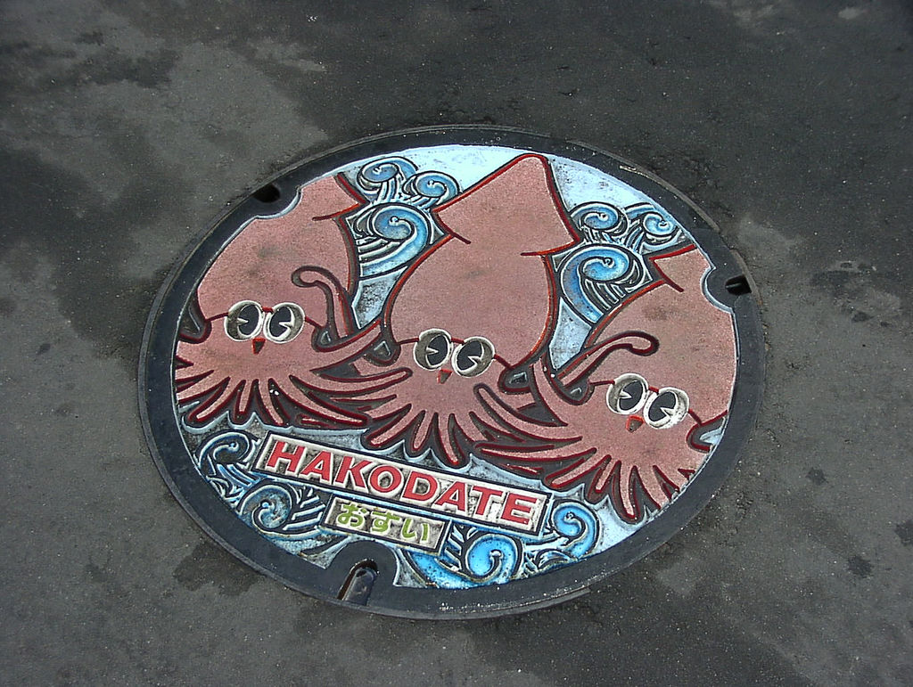
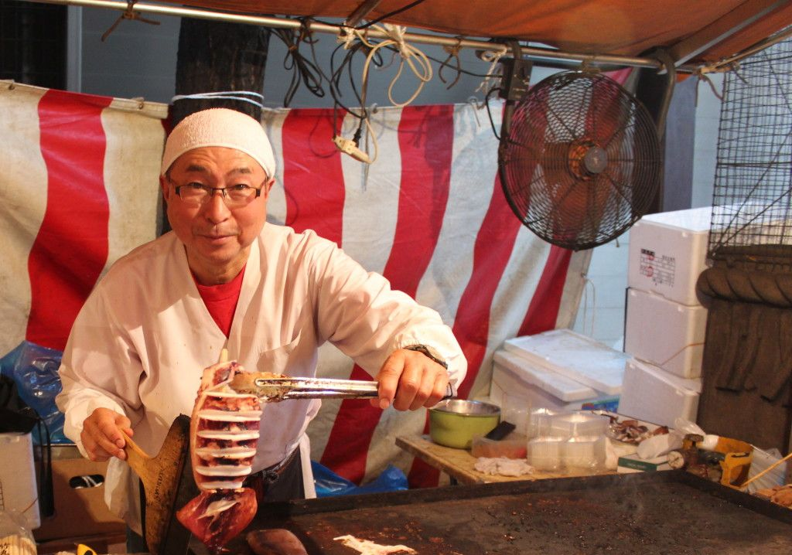
_
Villages like hakodate have annual festivals dedicated to the squid, and even perform festive dances to celebrate the harvest of these animals

Slide 5



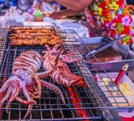
South Korea Also Has a Love for This Local Delicacy
Squid festival on beaches in Gangwon Province and Ulleungdo South Korea

Slide 6
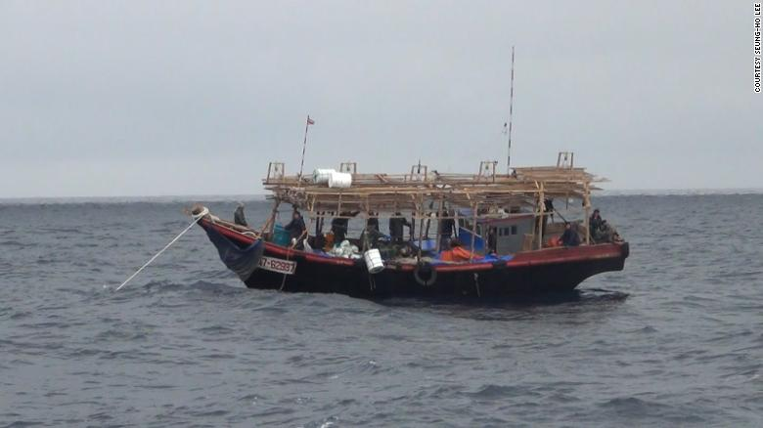
Korean Squid Fishing
Many fishing villages in North and South Korea do not have the capabilities the long-range Chinese vessels do.
These ships are small, with around 5 to 10 crew depending on the size. No bathrooms, no beds, water supply carried in jugs on deck.

Slide 7
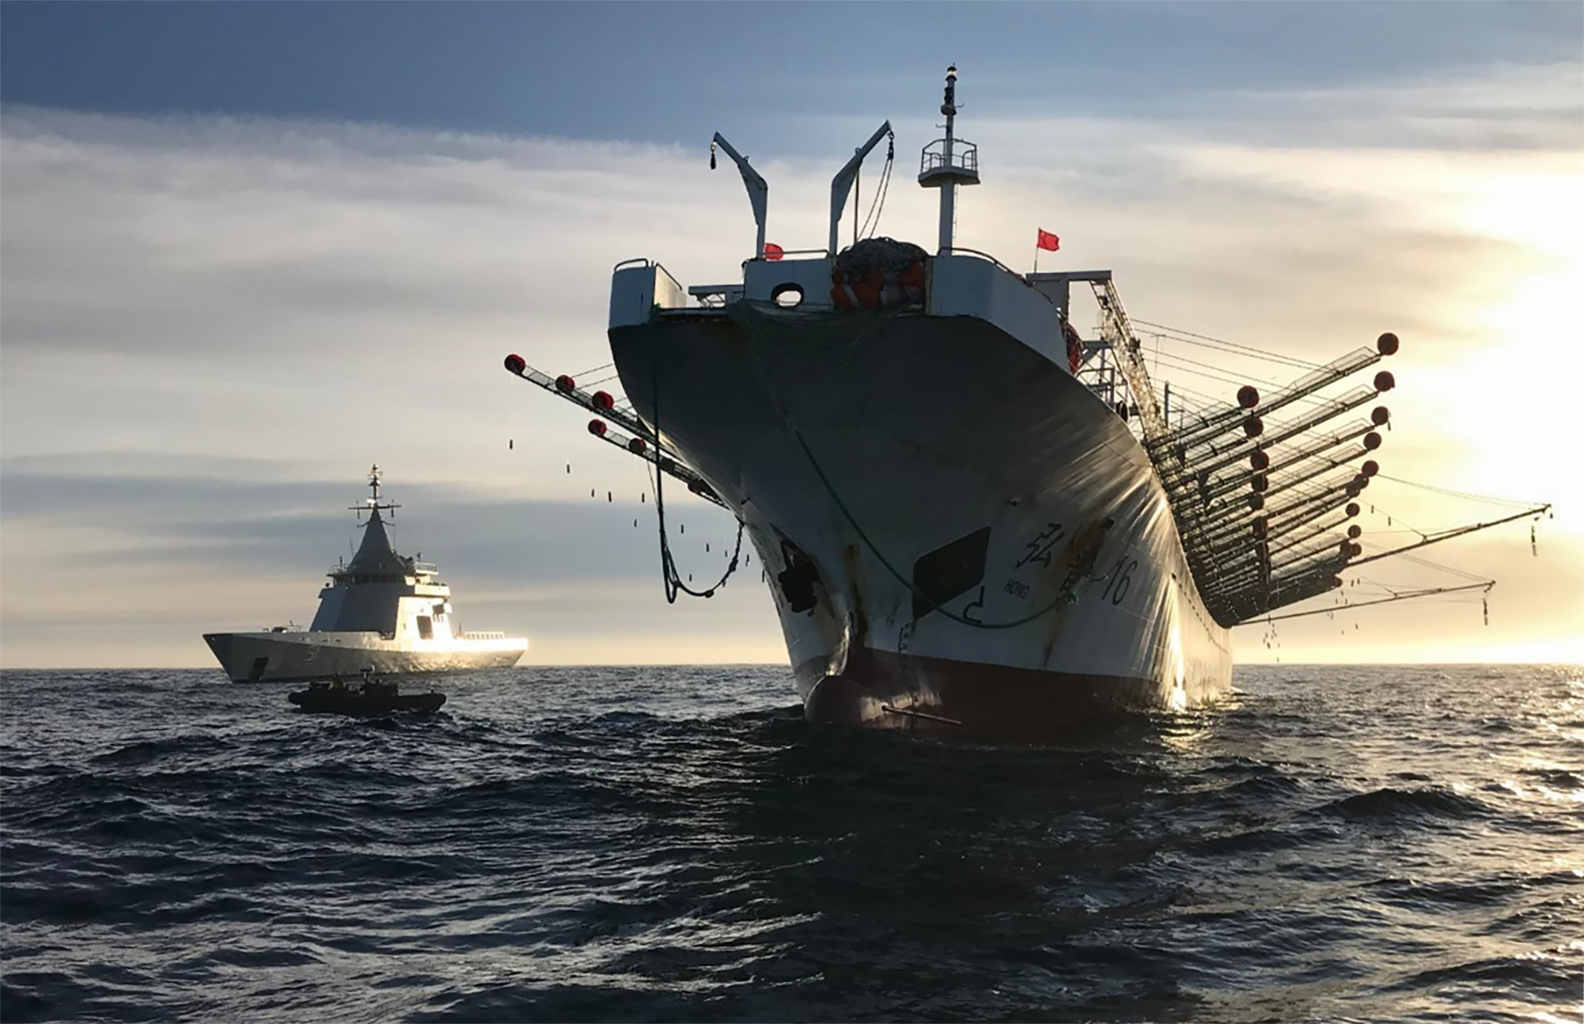

Slide 8
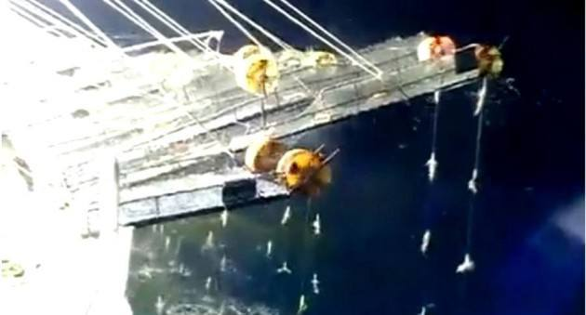
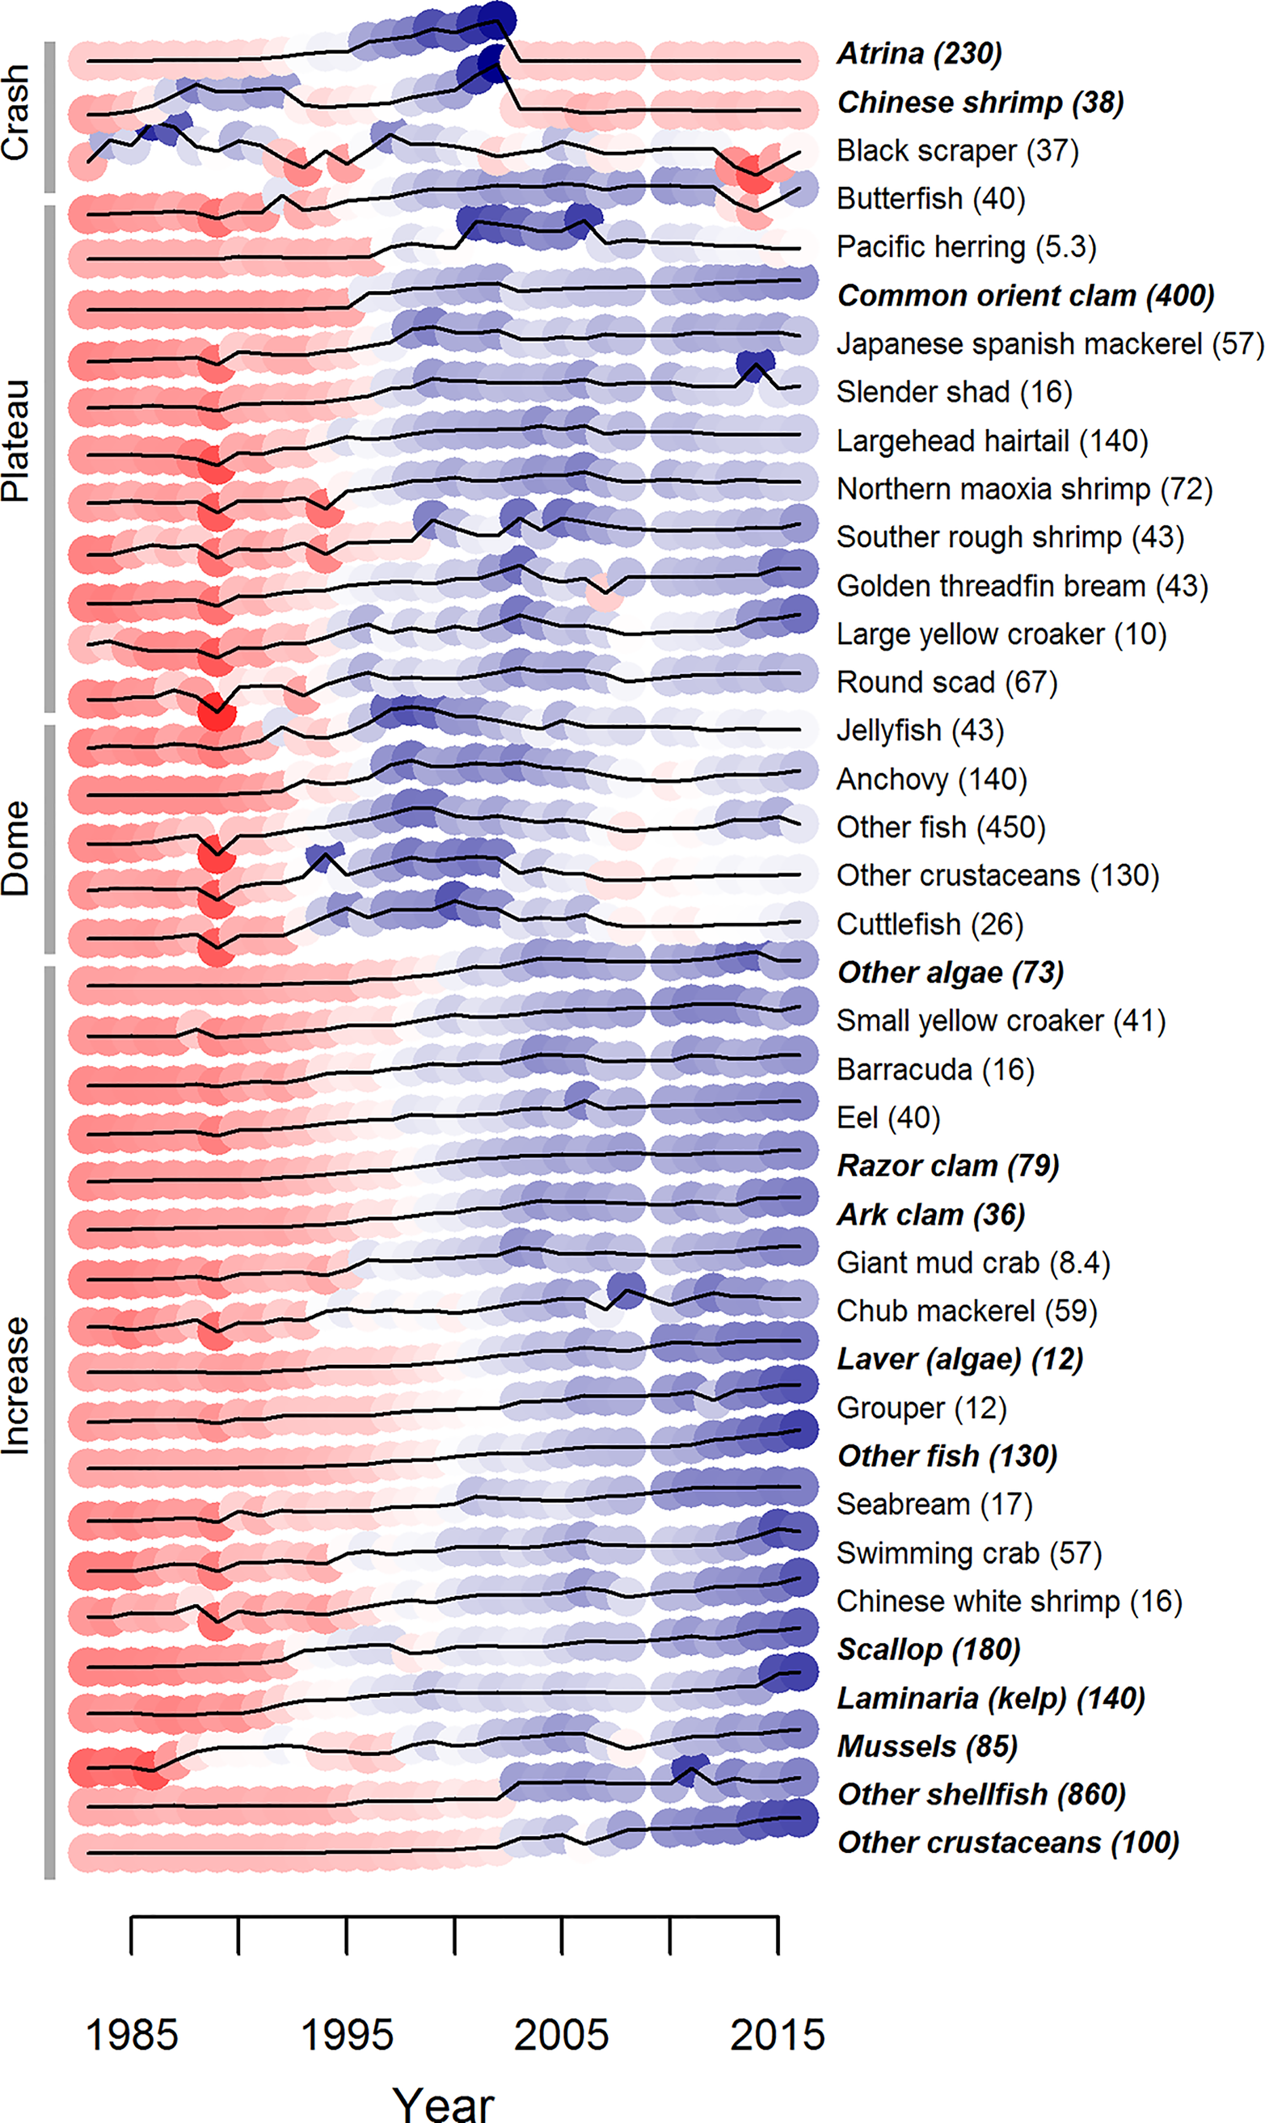
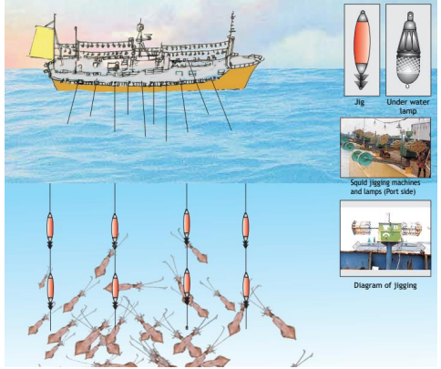
Appetites Are Out of Control
Squid “jigging” is one of the many innovations used to fish for squid. Light is used to attract the squid at night, who come up to the surface to feed. Light that is so bright, satellites can determine if it is a squid fishing vessel based on the level of intensity.

Slide 9
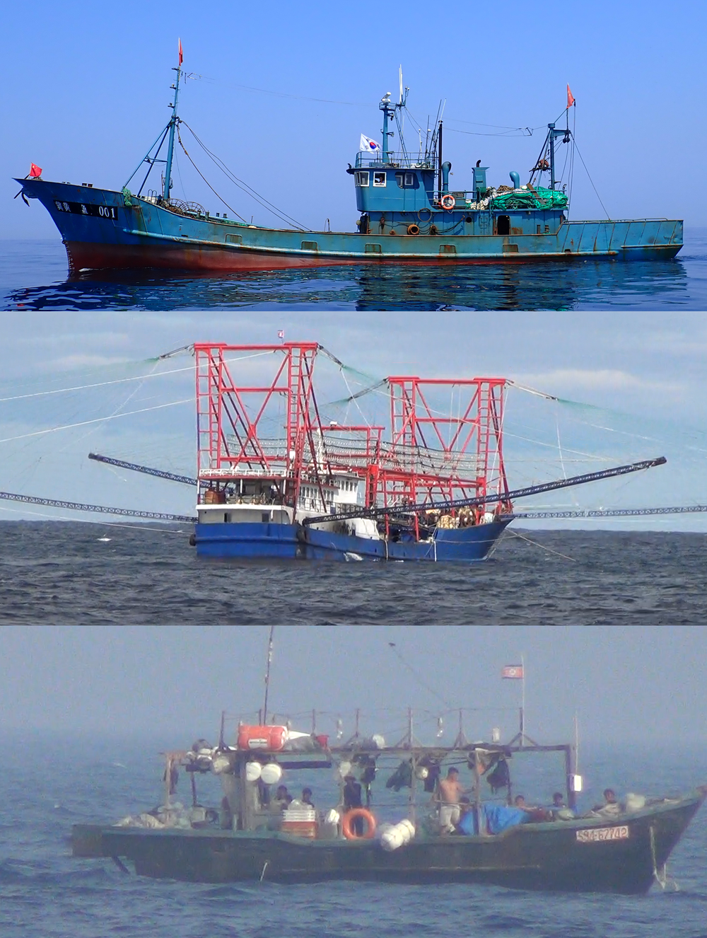
Comparing Vessels
Above is a Chinese pair trawler
Middle is a Chinese lighting vessel
Below is a typical Korean fishing vessel

Slide 10
Chinese waters and rounded the southern tip of South Korea. They entered North Korea’s 200 nautical-mile exclusive economic zone (EEZ), nearly doubling the number of Chinese fishing vessels operating there from 557 to 907, according a recent Global Fishing Watch report that tracked data from four different satellite systems. Even as China publicly claimed that is was complying with sanctions, many of the Chinese vessels continued to make trips to North Korea and back, including several round trips each year during both 2018 and 2019, said Jaeyoon Park, one of the report’s lead authors.
The Chinese fleet, made up of squid jiggers and pair trawlers, scooped up a staggering amount of squid—equal to almost as much as the entire squid catch in Japanese and South Korean waters combined over the same period, the report estimated. The Chinese decimated the squid population off North Korea to such a degree that Japanese and South Korean fishers saw their own take of the usually plentiful, migratory species plummet.
So the Chinese could clear out the squid undisturbed, the North Korean navy chased away North Korean fishing vessels from their own traditional fishing grounds, said Peter Oh, a defector from North Korea who monitors the country’s food situation and reports for Radio Free Asia. That’s because the Chinese were by no means unwelcome interlopers. In fact, they were fishing at the invitation of the North Korean government, Oh said. Citing South Korean intelligence sources, he said North Korea sold to China some 3,000 vessel licenses—each valid for one trip—beginning in 2017, up from around 900 in previous years. With each costing about half a million yuan ($73,000), the deal allowed Pyongyang to recoup $220 million of the estimated $1 billion export losses from the 2017 round of U.N. sanctions.

Slide 11
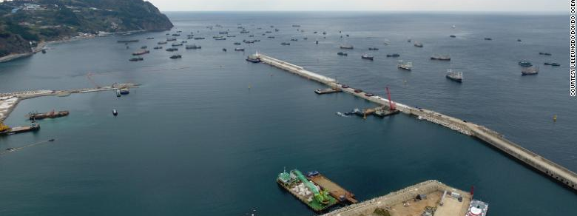
Fleets Such as These Show Up in Large Groups, Often Discarding Trash and Adding Pollutants to Waters
Chinese ships are seen sheltering from bad weather in Sadong port on Ulleung island in South Korea on November 11, 2017.

Slide 12
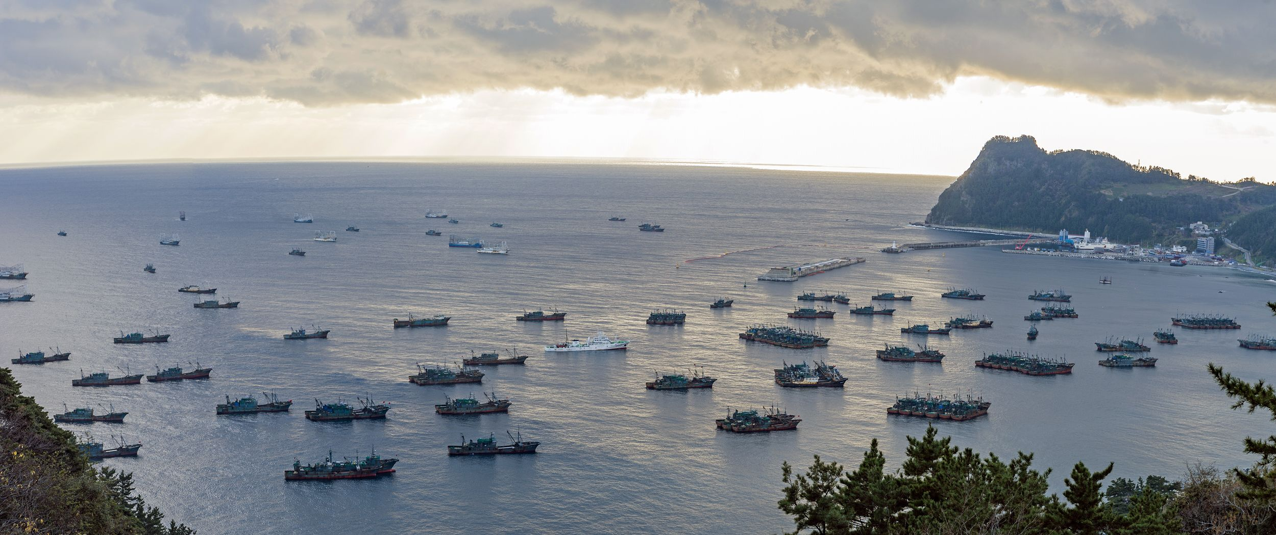
December 2016
Chinese fleets anchored in Sadong port, Ulleung-do, South Korea due to bad weather in North Korean waters on Dec. 6, 2016. There are two types of boats shown: shorter trawlers and longer, higher lighting boats. (Ulleung-gun County Office)

Slide 13
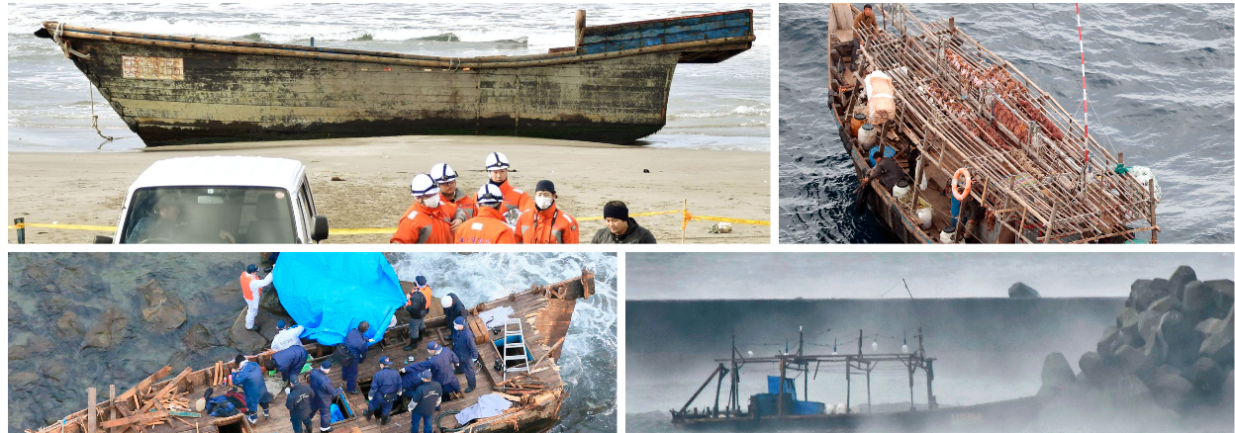
GHOST SHIPS
When North Korean ships travel out to far in search of squid, they often become trapped and succumb to the elements or run out of food/water. The vessels then drift onto the shores of Japan, often with a literal skeleton crew. 500 of these vessels have appeared in the last 5 years, each year more are found than were in the last.

Slide 14
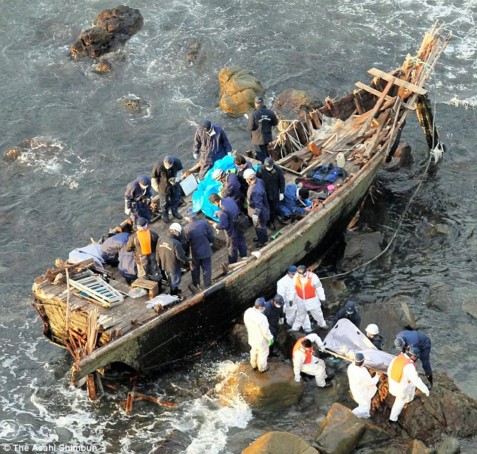
“So many North Koreans have disappeared at sea in recent years that some North Korean port towns, including Chongjin along the country’s eastern shore, are now called “widows’ villages.” Over the past two years, more than 50 bodies of North Koreans washed onto Japanese beaches, according to the Japanese Coast Guard”

Slide 15
A port State’s role in curbing illegal fishing 1. The vessel master seeking to enter port must provide the fisheries authority with information, including the identity of the vessel, the catch on board, fishing and transshipment authorizations, and details of any transshipments that have taken place. This needs to be submitted sufficiently in advance for the port State to process this information. 2. Port officials decide whether to authorize or deny the vessel’s entry into port, taking into account the vessel’s report and all other available information to determine whether it might have been involved in IUU fishing or fishing-related activities in support of IUU fishing. If the vessel is allowed into port, it is then subject to the port State’s jurisdiction. 3. If there is sufficient evidence that the vessel has been involved in or supported IUU fishing, the port State can either refuse the vessel entry into port or allow entry exclusively for the purpose of inspecting the vessel and taking other appropriate actions. Any such vessel entering into port must be denied port use for landing, transshipping, packaging and processing of fish and for other port services, including refueling and resupplying, maintenance and dry-docking. 4. If a vessel enters port and there are reasonable grounds to believe that it has been involved in IUU fishing, it must be refused permission to land or transship its catch and to use the port’s services. 5. A vessel must be refused permission to land or transship its catch and use the port’s services if the port State finds that the vessel does not have a valid authorization from the flag State or the coastal State to engage in fishing or fishing-related activities, the port State receives evidence that fish on board were taken in contravention of coastal State requirements, or the flag State does not confirm within a reasonable period of time that fish on board were caught in accordance with requirements of RFMOs. 6. A vessel must not be denied use of port services if the safety of the crew or the vessel, or the health of the crew, is at risk. 7. The port State may take other measures that go beyond the agreement’s minimum requirements, including measures in consultation or cooperation with the flag State and, if appropriate, coastal States and RFMOs. 8. The port State must transmit inspection reports and information on measures taken after inspection to the flag State and, as appropriate, other relevant States, RFMOs, the FAO and other relevant international organizations.
The agreement is a total of eight steps that must be followed by State officials and port authorities of participating countries.

Slide 16
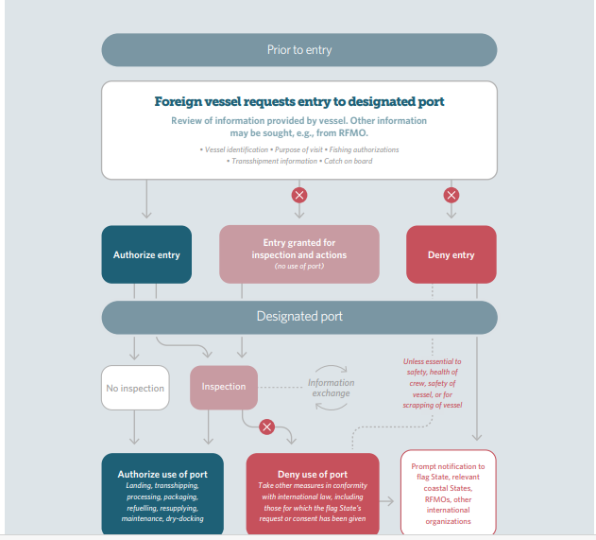
FAO Agreement Flow Chart
Provide credentials
Officials determine transfer to port jurisdiction
Port state can refuse entry
Deny usage of port
Must be refused if there is no valid auth under flag state
Vessel must not be refused emergency care
Port state may contact other states
Port state must share data with rfmo’s and fao

Slide 17
Albania 22. Ghana 39. Nambia 55. Somalia
Australia 23. Grenada 40. New Zealand 56. South Africa
Bahamas 24. Guinea 41. Nicaragua 57. Sri Lanka
Bangladesh 25. Guyana 42. Norway 58. Sudan
Barbados 26. Iceland 43. Oman 59. Thailand
Cabo verde 27. Indonesia 44. Palau 60. Togo
Cambodia 28. Japan 45. Panama 61. Tonga
Canada 29. Kenya 46. Peru 62. Trinidad and Tabago
Chile 30. Liberia 47. Philippines 63. Turkey
Costa rica 31. Libya 48. Republic of Korea 64. United Kingdom
Cuba 32. Madagascar 49. Saint Kitts and Nevis 65. United States of America
Cote dlvoire 33. Maldives 50. Saint Vincent and the 66. Uruguay
Denmark 34. Mauritania Grenadines 67. Vanuatu
Dijbouti 36. Montenegro 51. Sao Tome and Principe 68. Viet Nam
Dominica 37. Mozambique 52. Senegal
Ecuador 38. Myanmar 53. Seychelles
European union 54. Sierra Leone
Fiji
France
Gabon
Gambia
The Agreement on Port State Measures to Prevent, Deter and Eliminate Illegal, Unreported and Unregulated Fishing was approved by the FAO Conference at its Thirty-sixth Session (Rome, 18-23 November 2009) under paragraph 1 of Article XIV of the FAO Constitution, through Resolution No 12/2009 dated 22 November 2009.
The Agreement entered into force on 5 June 2016.
These are the current Parties to the Agreement
68 countries participate in this agreement, but not China.

Slide 18
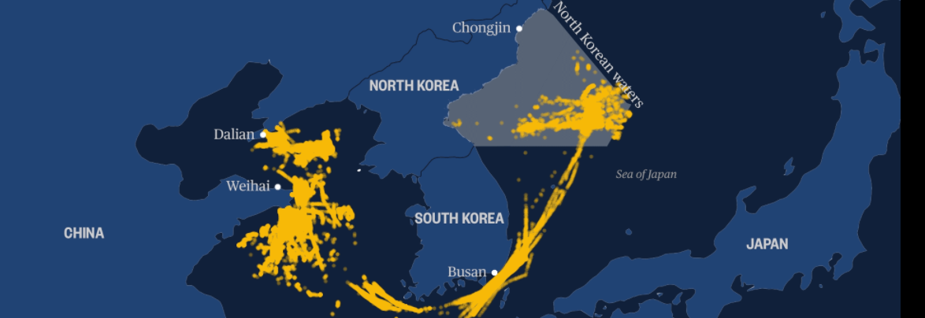
Squid fishing
Light tracking

Slide 19
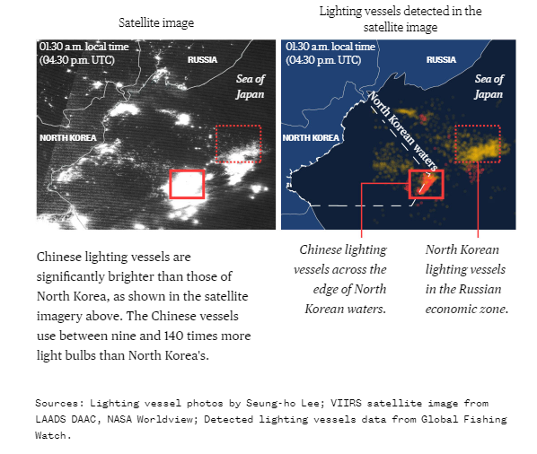
MOVEMENT
PUSHING NORTH

Slide 20
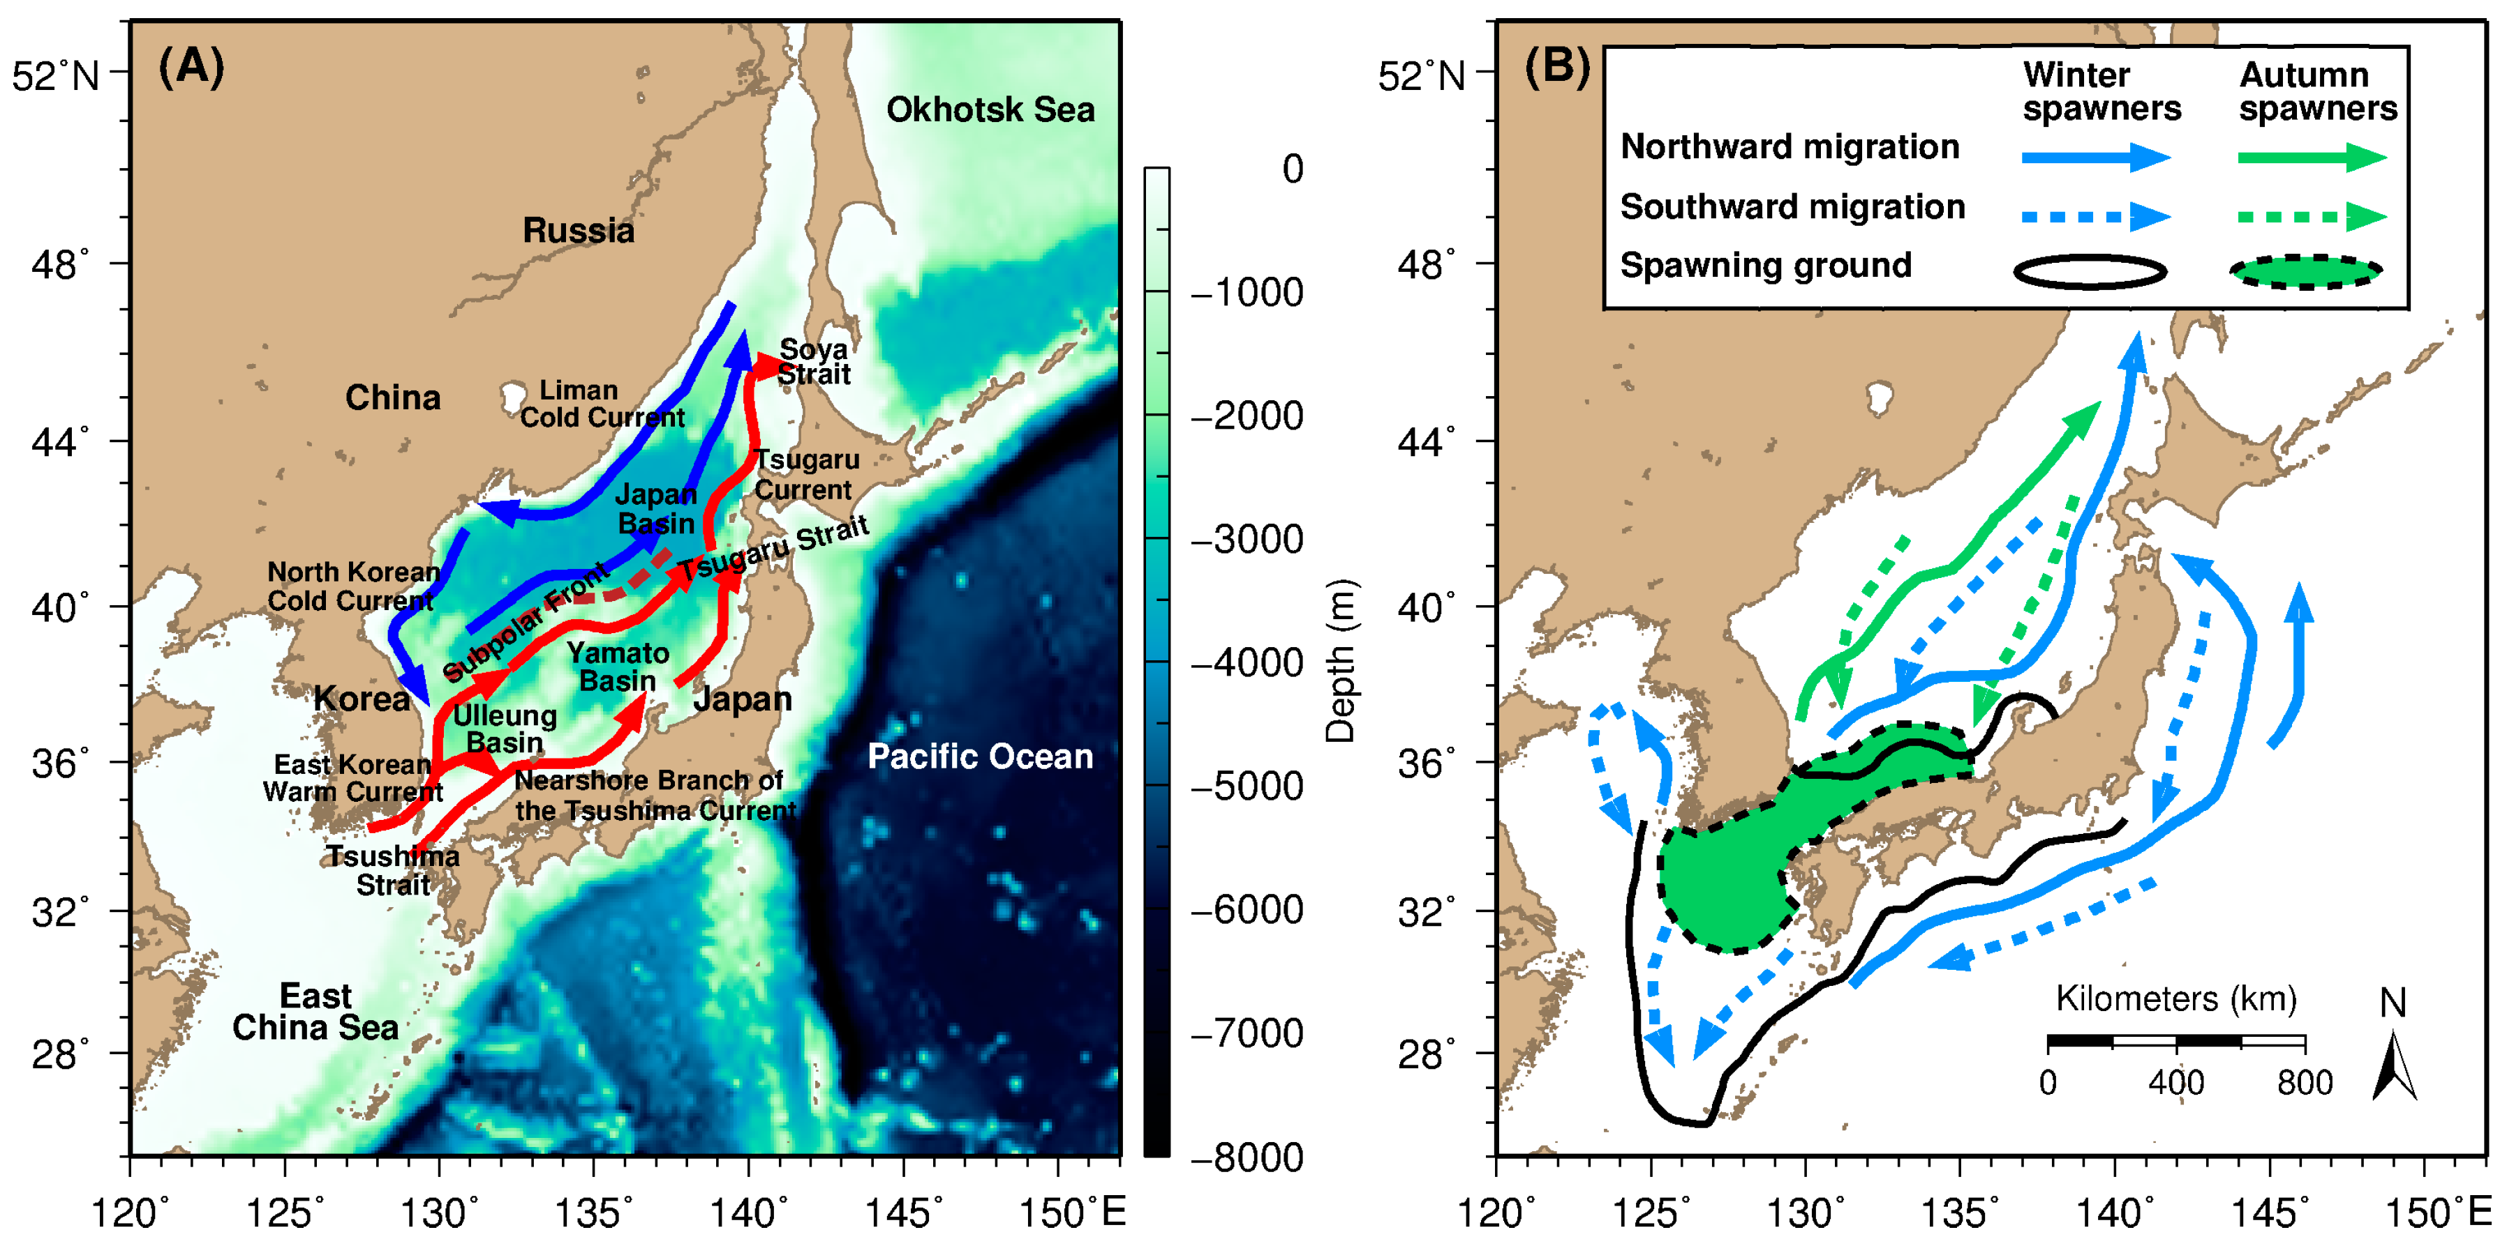
SQUID MIGRATION
50 TO 70 PERCENT OF SQUID CAUGHT IS BY CHINA

Slide 21
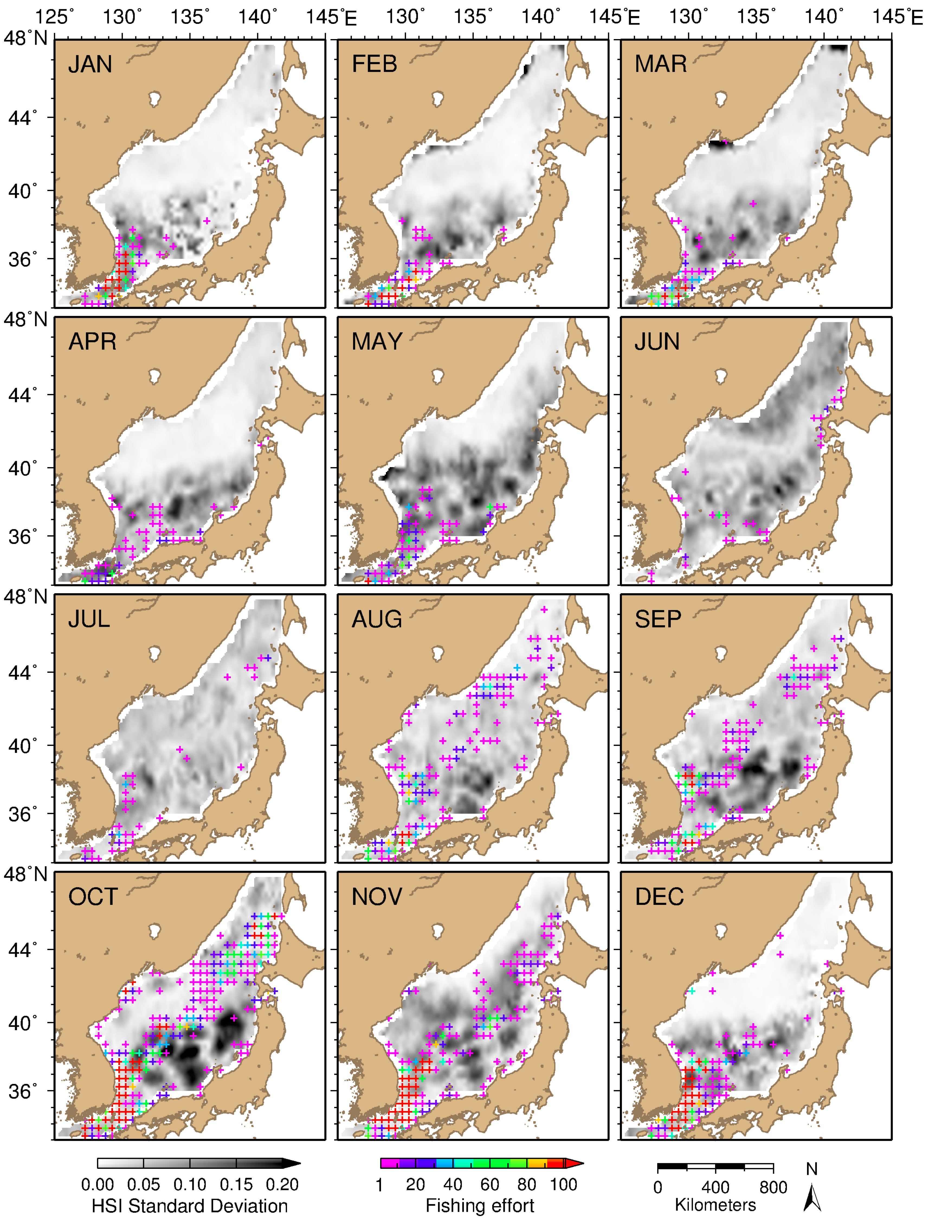
Migration Habits Expanded
50 TO 70 PERCENT OF SQUID CAUGHT IS BY CHINA

Slide 22
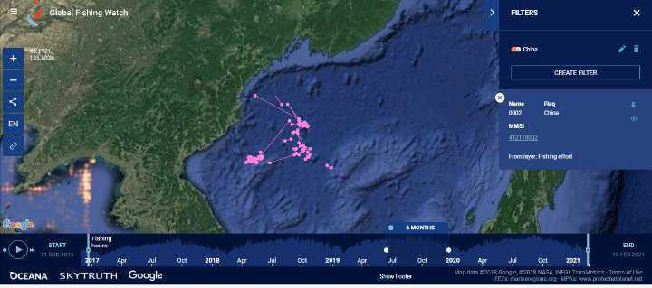

Slide 23
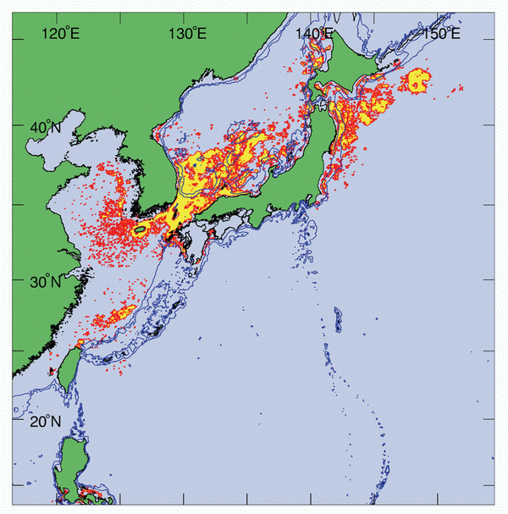
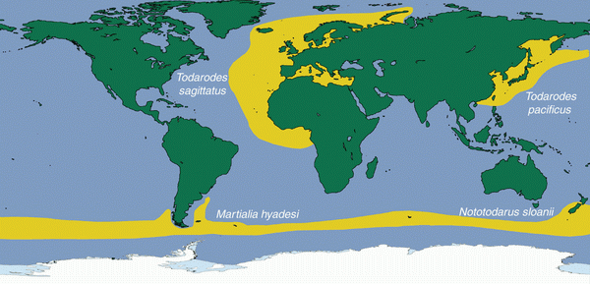

Slide 24
Liaoning Province | OEC - The Observatory of Economic Complexity
Shandong Province | OEC - The Observatory of Economic Complexity
Jilin Province | OEC - The Observatory of Economic Complexity
Hainan Province | OEC - The Observatory of Economic Complexity
The deadly secret of China’s illegal fishing armada: It’s killing impoverished North Korean squid fishermen (nbcnews.com)
Russia (RUS) Exports, Imports, and Trade Partners | OEC - The Observatory of Economic Complexity
Unmasking China's illegal squid fishing fleet in North Korea (digitaljournal.com)
Ocean Shock - In land of sushi, squid moves out of reach | Reuters
FAO Fisheries & Aquaculture - Country Profile
Fishing industry in Russia – Wikipedia
Marine seafood production via intense exploitation and cultivation in China: Costs, benefits, and risks (plos.org)
Exclusive economic zone of Russia – Wikipedia
China's 'Dark' Fishing Fleet Lays Waste to Global Ecosystems — Radio Free Asia (rfa.org)
How is China Feeding its Population of 1.4 Billion? | ChinaPower Project (csis.org)
China looks to big data to improve fisheries, aquaculture management (seafoodsource.com) China looks to big data to improve fisheries, aquaculture management (seafoodsource.com
Humboldt squid - Wikipedia)
Remote Sensing | Free Full-Text | Seasonal Habitat Patterns of Japanese Common Squid (Todarodes Pacificus) Inferred from Satellite-Based Species Distribution Models | HTML (mdpi.com)

